Slide 1


Analyzing Spotify Reviews with NLP
Hope Miller

Slide 2
Purpose
1
2
3
Background
Goal
Approach
- As of today, Spotify has over 27.2 million reviews on the Google Play app store and 25 million on the Apple App Store
- Develop a way to quickly analyze customer satisfaction and get customer insight related to the app.
- Bigs and applications errors may also be uncovered through reviews.
- Over 61,000 reviews were scraped off the Google Play app store
- Looking at what the customers say in their ratings gives un-bias insight into how Spotify is doing, in terms of customer satisfaction.

Slide 3
Method
1
- Clean and prep data
- Adding a sentiment tag
3
- Evaluate the model for accuracy
- Use the Bag of Words method to pull out key findings
2
Build a Multinomial Naive Bayes (MNB) model
Train the data
4

Slide 4
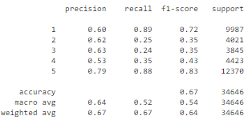
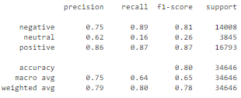
Results: MNB Model
Ratings: 67% accuracy
Sentiment Analysis: 80% accuracy

Slide 5
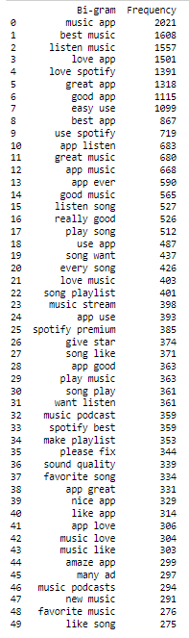
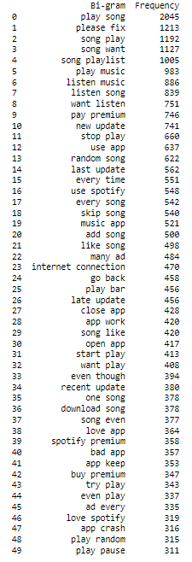
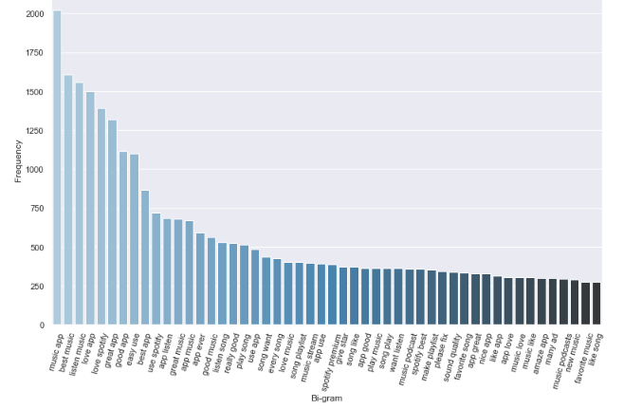
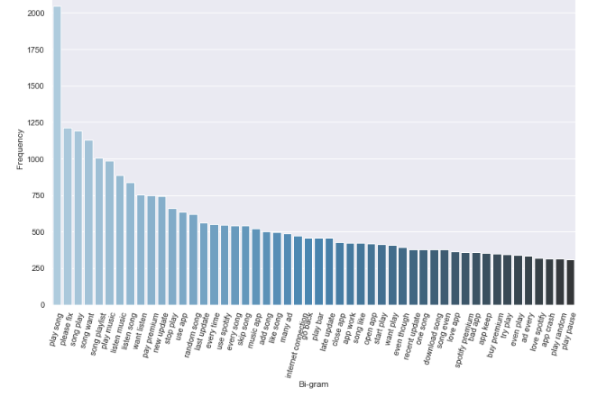
Results: Key Findings
Positive Reviews: The app overall, vast song selections, Spotify Premium, and podcast
Negative Reviews: Paying for Spotify Premium, ads, not being able to skip songs, song suggestions, and new updates

